Slide 1
Panaverse
Preparing for the Next Generation
of the Internet
www.panaverse.co

Slide 2

—Matthew Ball
“The future of the internet: A massively-scaled, persistent, interactive, and interoperable real-time platform comprised of interconnected virtual worlds where people can socialize, work, transact, play, and create.”
The Metaverse: And How it Will Revolutionize Everything

Slide 3

“The metaverse is a 3D version of the Internet and computing at large.”

Slide 4
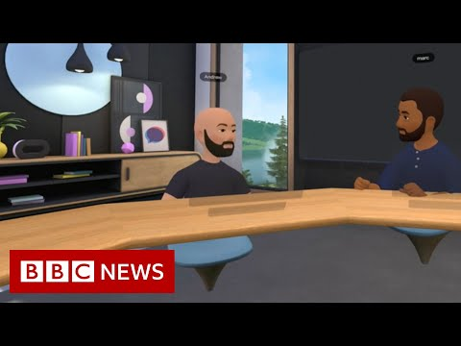
What is the Metaverse?

Slide 5
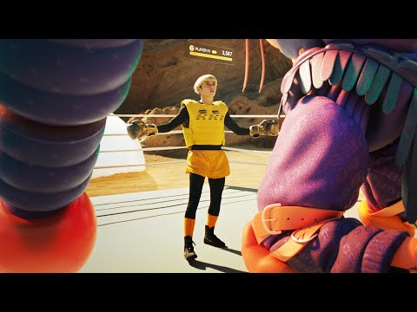
Facebook’s Vision for Metaverse

Slide 6
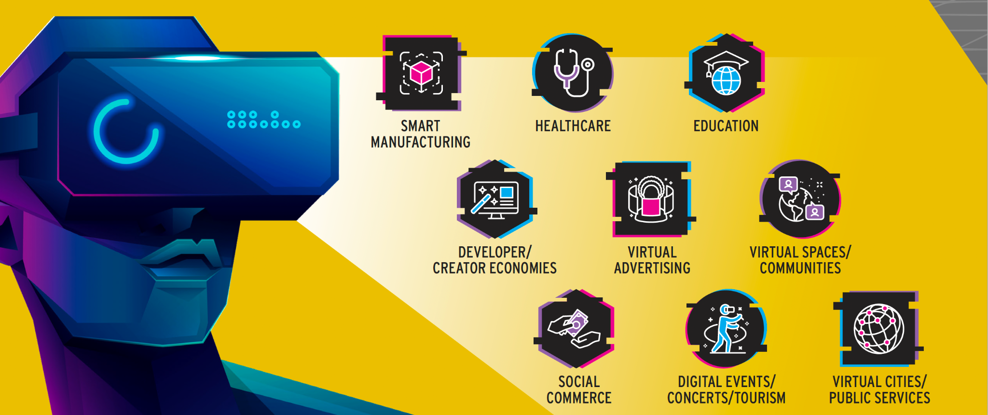
Metaverse Use Cases

Slide 7

13 Trillion
Citi estimates that total addressable market for the Metaverse Economy could grow from $8 Trillion to $13 Trillion with 5 billion unique global users by 2030.
Metaverse and Money: Decrypting the Future

Slide 8
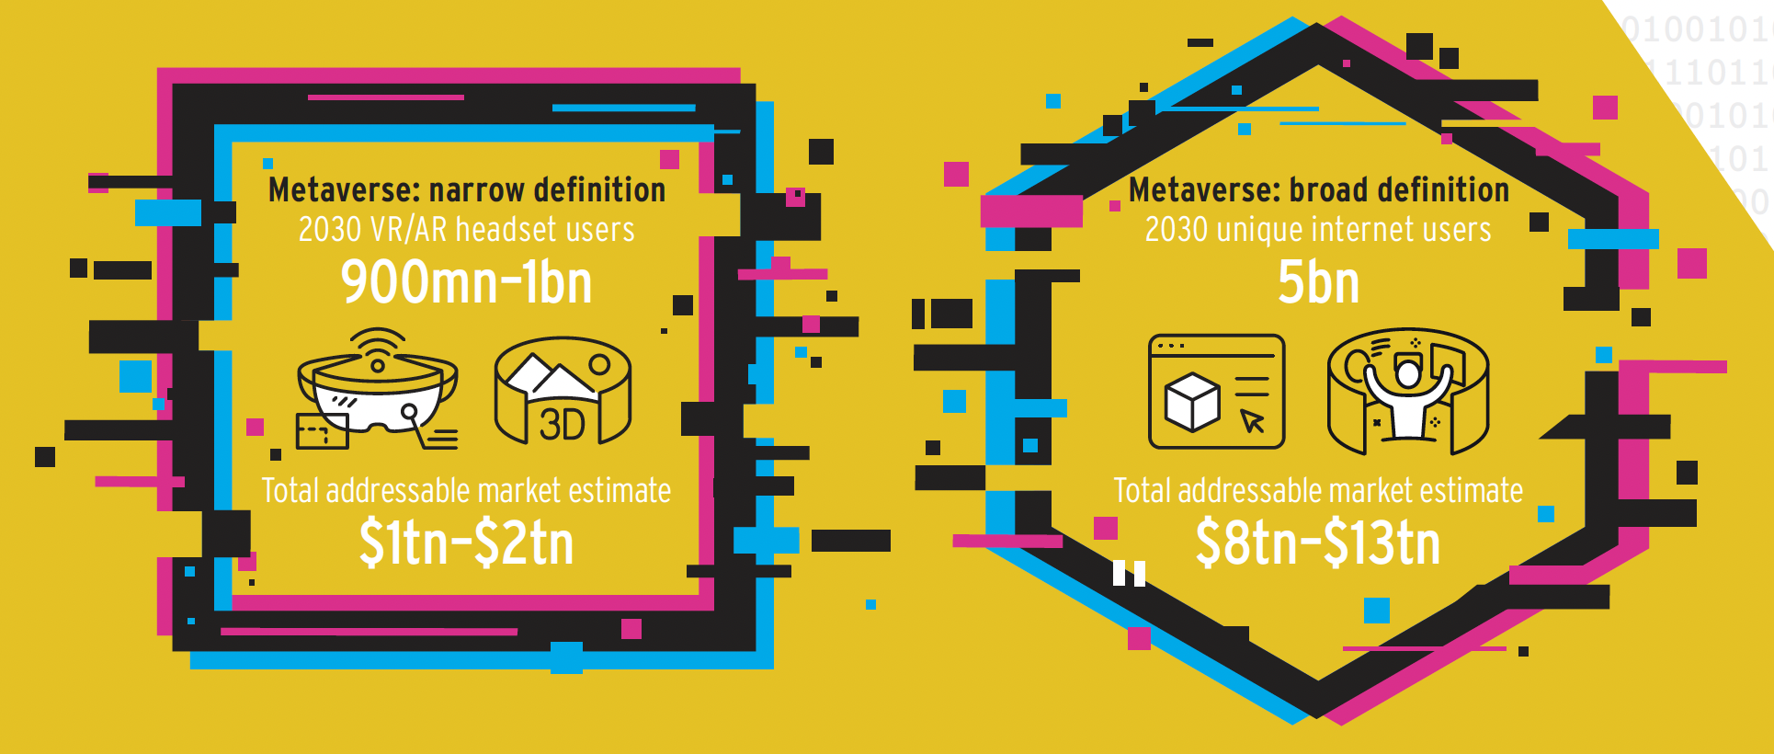
Metaverse Market Potential

Slide 9
Money in the Metaverse
The Metaverse will include existing forms of payments such as credit cards with Fiat money.
In addition, new forms of payments will be accepted:
Cryptocurrency & Tokens
Stablecoins
Central Bank Digital Currencies (CBDCs)

Slide 10
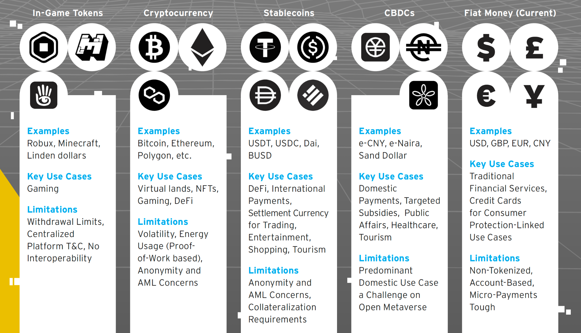
Metaverse Money

Slide 11
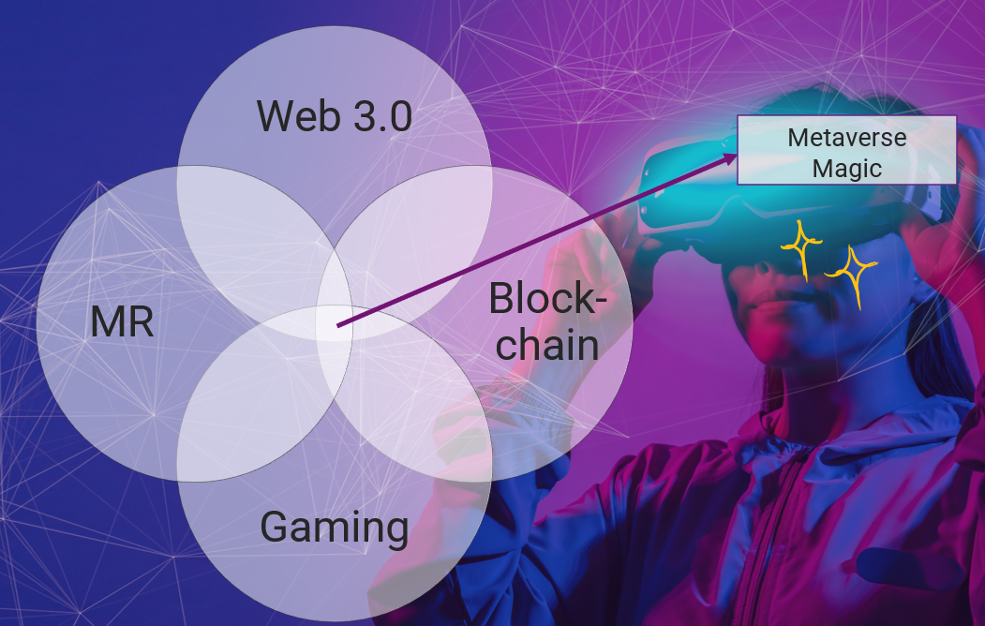
What does Web 3 have to do with Metaverse?
Based on ownership and decentralization and facilitated via blockchain, Web3 refers to the conceptual third iteration of the internet.
The so-called “Open Metaverse” is built upon blockchain — mainly the Ethereum chain — and overlaps with Web3.
Many Web2 centralized platforms will play an important role in the Metaverse, and even Web3 today relies on elements of centralization.

Slide 12
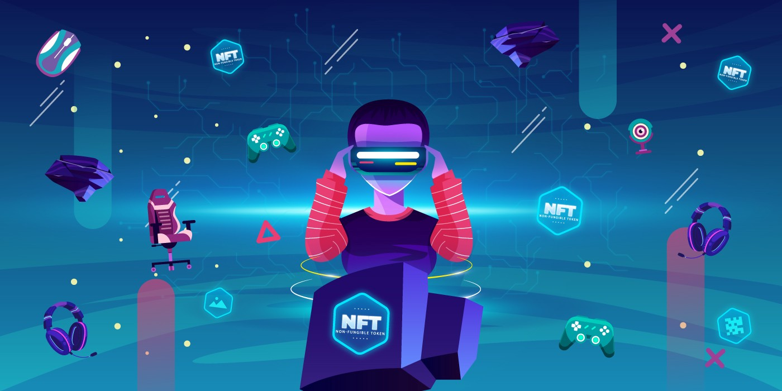
What’s the Role of NFTs in the Metaverse?
NFTs in the Metaverse enable a form of sovereign ownership for users/owners and are
Tradeable
Composable
Immutable
Mostly interoperable
Increased interest from gamers, investors, and corporates in the NFT space in recent months.
NFTs in the Metaverse are virtual items stored in a digital wallet that can be taken everywhere within the Metaverse.

Slide 13

What’s the Role of AI in the Metaverse?
AI for immersive digital worlds
AI as a creative partner
Intelligent networking
Smart hyper-personalized games, experiences, education and welfare

Slide 14

What’s the Role of APIs in the Metaverse?
APIs will:
Help create the Metaverse.
Speed up immersive experiences development time and cut costs.
Be used by Metaverse Developers to change product code without needing to start from scratch.
Be used more heavily in the future, as the Metaverse proliferates.
Be a fundamental building block of Metaverse, Web 3.0 and the future of the internet.

Slide 15

What’s the Role of Cloud Computing in the Metaverse?
The essence of the Metaverse is still cloud computing.
Scalable AI and APIs can only be built economically on the cloud.
Only Serverless Cloud Computing can meet the scalability requirements of the Metaverse.
What Metaverse itself needs is computing, storage, machine learning, etc., which are inseparable from cloud computing.
The architecture of Metaverse will be event-driven which means it will be a Serverless Metaverse.

Slide 16
Global Tech Talent Shortage
The global talent shortage already amounts to 40M skilled workers worldwide.
By 2030, the global talent shortage is predicted to reach 85.2M workers. Сompanies worldwide risk losing $8.4T in revenue because of the lack of skilled talent.
According to a CNBC report, the software developer shortage is alarming in 2022. The rate of unfilled IT jobs in USA increased to 918,000 vacancies at the end of 2021.
Another report noted that by 2030, the number of software job vacancies would rise by almost 22%. The average growth rate of software developers in the USA is only 8% right now, and that clearly emphasizes there is already an overwhelming and severe shortage of skilled workers.
85 Million
By 2030

Slide 17
So who will build the Metaverse?

Slide 18
A Global Mass Developer Training Program will Solve the Talent Shortage

Slide 19








Developer Skill Set: Web2
TypeScript
VS Code
Next.js
AWS CDK
Serverless
CLI
Frontend & Backend Development
Integrated Development Environment
Front End Development Framework
Infrastructure as Code
AWS Lambda, API Gateway, AppSync, and Aurora for API Development
Panacloud CLI for API Development

Slide 20






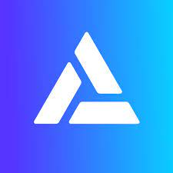


Developer Skill Set: Web3
Ethereum
Solidity
OpenZeppelin
Hardhat
Ethers.js
Metamask
Alchemy
The Graph
Chainlink

Slide 21
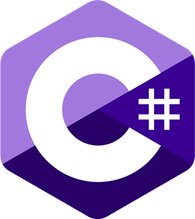



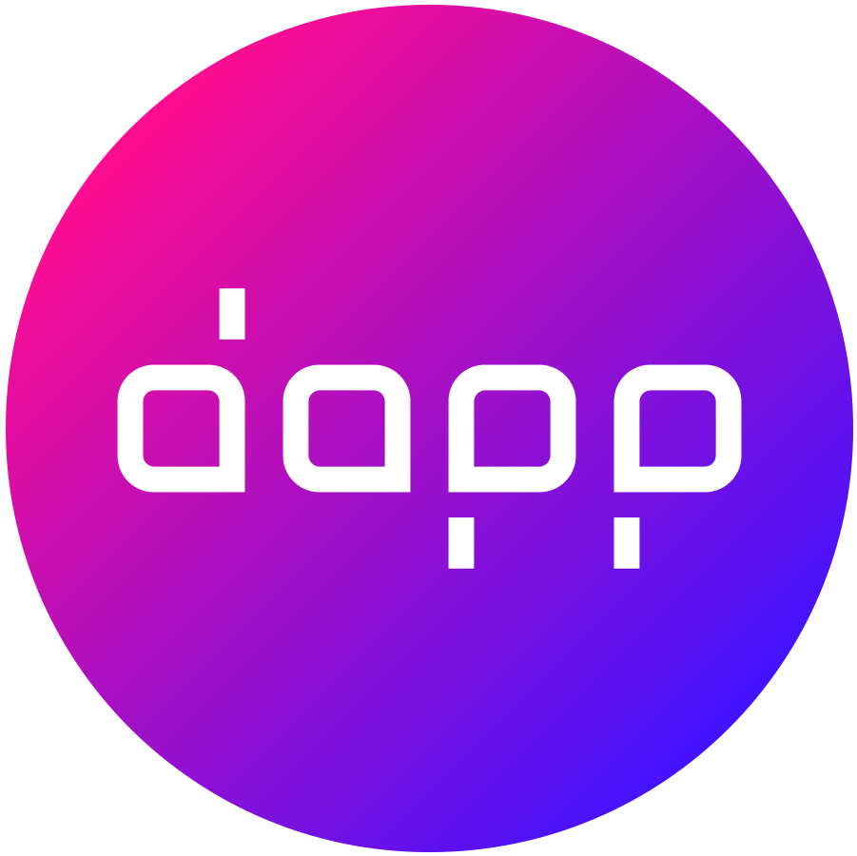
Developer Skill Set: Meta 3D
C#
Unity 3D
Blender
Graphics
DAPP
Unity XR Programming
3D Development Platform
3D Modeling
Computer Graphics Programming
Designing Metaverse DAPP Experiences

Slide 22
1 Year Certification Program
Onsite, Online, and Pre-recorded classes
Partnerships with Universities and NGOs to utilize excess capacity on weekends and evenings.
Onsite classes in auditoriums.
Four hours of onsite classes per week, the rest in online classes and recorded videos.
Two hours of online classes per week.
Students selected based on entrance exams at a mass level.
Program cost less than $20 per month.

Slide 23
1 Year Post Graduate Diploma
PGD in Web 3 and Metaverse
ID | Quarter | C-Code | Course Title | Cr-H
1 | 1 |  | Intro to Computer Science | 3
2 | 1 |  | Introduction to Programming | 3
3 | 1 |  | Object Oriented Programming | 3
4 | 2 |  | Advanced Web 2.0 Development | 3
5 | 2 |  | Metaverse Development | 3
6 | 2 |  | Smart Contract Development | 3
7 | 3 |  | Decentralized App Development | 3
8 | 3 |  | Cross Platform Metaverse Development | 3
9 | 3 |  | Serverless API Development | 3
10 | 4 |  | Advanced Web 3.0 Development | 3
11 | 4 |  | Computer Graphics Programming | 3
12 | 4 |  | Designing & Developing Metaverse DApp Experiences | 3
Total |  |  |  | 36

Slide 24
2 Year Associate’s Degree
Associate's Degree in Computer Science (Web 3 and Metaverse)
ID | Semester | C-Code | Course Title | Description | Cr-H
1 | 1 |  | Intro to Computer Science | Web 3 & the Metaverse | 3
2 | 1 |  | Introduction to Programming | C# for Metaverse | 3
3 | 1 |  | Object Oriented Programming | TypeScript | 3
4 | 1 |  | English-I | Elective - Expository Writing | 3
5 | 1 |  | UI/UX Design | Elective - Arts & Humanities | 3
6 | 1 |  | Linear Algebra | Elective - Quantitative Reasoning | 3
7 | 2 |  | Advanced Web 2.0 Development | NextJS | 3
8 | 2 |  | Metaverse Development | Unity & C# | 3
9 | 2 |  | Smart Contract Development | Solidity & Hardhat | 3
10 | 2 |  | English-II | Elective - Expository Writing | 3
11 | 2 |  | Pakistan Studies | Elective - Civilization Courses | 3
12 | 2 |  | Applied Physics | Elective - Natural Sciences | 3

Slide 25
2 Year Associate’s Degree
Associate's Degree in Computer Science (Web 3 and Metaverse)
ID | Semester | C-Code | Course Title | Description | Cr-H
13 | 3 |  | Decentralized App Development | EthersJS, NextJS, & Solidity | 3
14 | 3 |  | Cross Platform Metaverse Development | Unity & C# | 3
15 | 3 |  | Serverless API Development | Amazon Web Services | 3
16 | 3 |  | English-III | Elective - Expository Writing | 3
17 | 3 |  | Tokenomics | Elective - Social Sciences | 3
18 | 3 |  | Physics for Game Developers | Elective - Natural Sciences | 3
19 | 4 |  | Advanced Web 3.0 Development | DAO, Oracles, Graphs, DeFi, & Tokenomics | 3
20 | 4 |  | Computer Graphics Programming | Elective - Quantitative Reasoning | 3
21 | 4 |  | Designing & Developing Metaverse DApp Experiences | Elective - Arts & Humanities | 3
22 | 4 |  | Political Science & Government | Elective - Social Sciences | 3
23 | 4 |  | Comparative Religion | Elective - Civilization Courses | 3
Total |  |  |  |  | 69

Slide 26

Why Us?
We have Extensive Experience of Conducting Mass Training Programs. Currently, we are running the President of Pakistan’s Initiative for AI & Computing (PIAIC).
www.piaic.org

Slide 27
The Pakistan Panaverse Timeline
Web 3.0 Faculty Training
Started training Web 2.0 and Web 3.0 Faculty Members who are Mainly Developers.
Mass Training Started in Pakistan
Training started at a Mass Level in Major Cities of Pakistan in AI, Cloud, and Blockchain .
Limited Metaverse Nationwide Training in Pakistan
Started Training Metaverse Faculty Members and early adopters across Pakistan. .
2000
Jan 2022
2023
1998
2001
Aug 2022
AI and Cloud Faculty Training
Started Training AI and Cloud Faculty Members who are Mainly Developers
Started Developing Web 3 Products
Founded Web 3 Startups
Metaverse Mass Nationwide Training
Launch a Mass Training Program all over Pakistan. Incorporate it in Regular University Programs..

Slide 28
The Global Panaverse Timeline
Web 3.0 Startup and Services in USA
Launch Web 3.0 API startup and Services companies in West and East Coasts
Metaverse Services in USA
Launch Metaverse Services in USA
Metaverse and Web 3.0 Training in China
Will start offering Metaverse and Web 3.0 Training with Local Partners in China.
March 2023
Aug 2023
2024
Aug 2022
June 2023
Jan 2024
Web 3.0 Startup and Services in Dubai
Launch Web 3.0 Asset Fractionalization Startup and Exchange in Dubai. Also offer Web 3.0 and Metaverse Services.
Metaverse and Web 3.0 Training and Services in Dubai
Will start offering Web 3.0 Services and Training with Local Partners in Dubai.
Metaverse and Web 3.0 Training in Turkey and Egypt
Will start offering Metaverse and Web 3.0 Training with Local Partners in Turkey and Egypt.

Slide 29
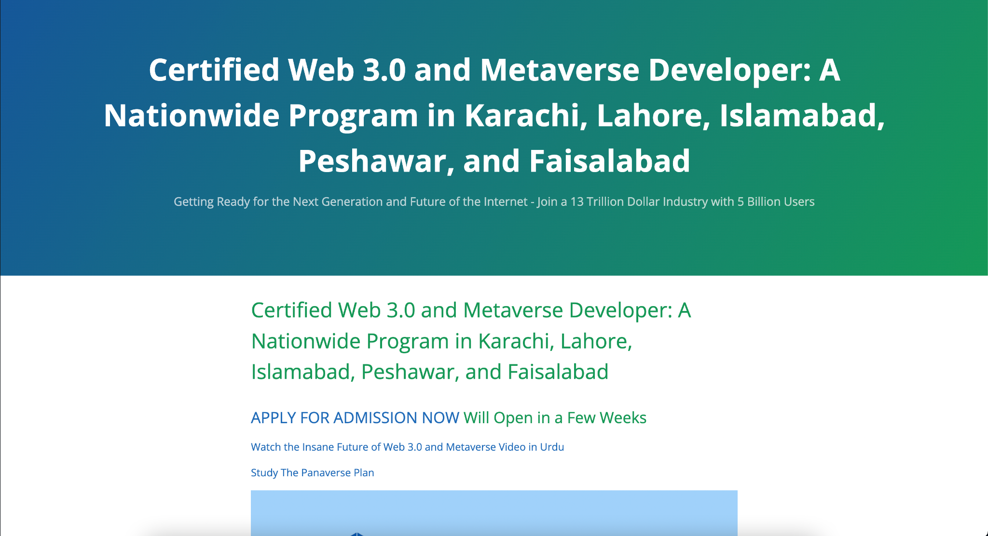
Metaverse & Web3
Training Program
www.panaverse.co

